Slide 1
GA·AWARDS Data: Understanding the Governor’s Office of Student Achievement’s Report Card & Dashboards
Jaya Krishnan – GA·AWARDS
Michael Moore – GA·AWARDS
Monica Flamini – Policy, Research, and Evaluation
Stacey Lutz – Director, Strategic Programs and Evaluations

Slide 2
What is the Governor’s Office of Student Achievement (GOSA)?
GOSA’s mission is to support accountability and transparency through strategic data use and collaboration with education stakeholders to advance student success.
As the state's P-20 education agency, the Governor's Office of Student Achievement works to increase academic achievement and school completion across the state.
The agency maintains an education scoreboard that tracks the effectiveness of the state’s Pre-K through college programs, audits these programs to ensure that state funds are well used, and analyzes and shares with the public data about trends in education.
Notes:
2 minutes

Slide 3
What is GA·AWARDS?
GA·AWARDS is a data repository containing quality information that researchers value to analyze data, inform policy, and implement improvements for student success in education and workforce development in the State of Georgia.
GOSA hosts GA·AWARDS, but GOSA does not own the participating agencies’ data.
Notes:
2 minutes

Slide 4
Data Governance Structure
Data Management Committee
(Leadership from Participating Agencies)
GOSA Data Strategy and Business Operations Director – Jackie Lundberg
DOE
DECAL
SCSC
TCSG
USG
GICA
GSFC
GOSA
PSC
DOL
Support Staff
Support Staff
Support Staff
Support Staff
Support Staff
Support Staff
Support Staff
Support Staff
Support Staff
Support Staff
Support Staff =
Research Group
(Users of GA·AWARDS – Report Drivers)
Data Leads
(Data Owners)
Business Intelligence Group
(Report Support)
Data Stewards
(Manage Data Corrections)
Notes:
3 minutes

Slide 5
How is the Data Collected?
Detail Level Data vs. Aggregated Data
Personal Identifiable Information (PII) used to link longitudinal record of students over time (Pre-K through Workforce)
Annual Collections from Participating Agencies:
Department of Early Care and Learning (DECAL)
Department of Education (DOE)
State Charter Schools Commission (SCSC)
Georgia Student Finance Commission (GSFC)
Professional Standards Commission (PSC)
Technical College System of Georgia (TCSG)
University System of Georgia (USG)
Georgia Independent College Association (GICA)
Governor’s Office of Student Achievement (GOSA)
College Board, ACT, and National Student Clearinghouse (used to locate students attending colleges outside Georgia)
Department of Labor (DOL)
Georgia Military College (GMC)
Notes:
5 minutes
Quarterly: GICA, GMC, USG, DOL

Slide 6
Data Collection, Continued
Student Count Nuances:
Federal Free and Reduced Priced Lunch (FRL) data comes from schools’ student level data (Community Enrichment Program).
Keep in mind when comparing GOSA and GaDOE dashboards:
There are minor differences in enrollment counts between GOSA and GaDOE dashboards because of types of counts used (student record, FAY, FTE).

Slide 7
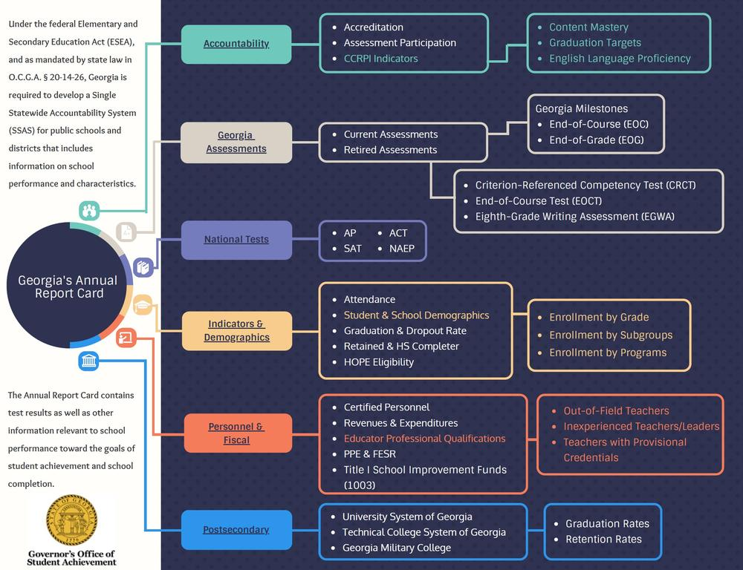
What is the Report Card?
Notes:
2 minutes
As part of this mission, GOSA presents its annual report on Georgia's public education agencies.
GOSA hopes that the information contained in these reports and future reports will provide educators, leaders, parents, students, and all stakeholders with valuable information and challenge communities to improve

Slide 8
Legal Function of the Report Card
Federal Statutes Guiding Accountability:
No Child Left Behind (NCLB)
Every Student Succeeds Act (ESSA)
To comply with the current ESSA statute, schools link to GOSA’s Report Card and School Grades site.
Notes:
2 minutes, brief policy history and how it’s mandated by USDoE

Slide 9
Navigating the Report Card Dashboard
gosa.georgia.gov → Dashboards, Data, Report Card → Report Card → K-12 Public Schools
K-12 Public Schools
District/School
Notes:
Ask how many people know if this data dashboard exists and if they have used it.
10 minutes

Slide 10
Navigating the Report Card Dashboard
gosa.georgia.gov → Dashboards, Data, Report Card → Report Card → K-12 Public Schools
Data by Type

Slide 11
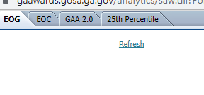
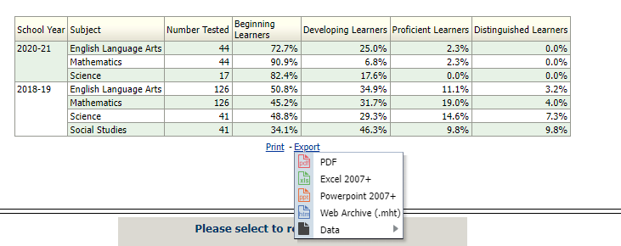
Example
Type of school (ex: E, M, H) will inform what testing data is available (ex: EOC or EOG)
1. District: Atlanta Public Schools
2. School: Benteen Elementary
3. Georgia Assessments (Current)
Can export student performance data comparisons as Excel or PDF

Slide 12
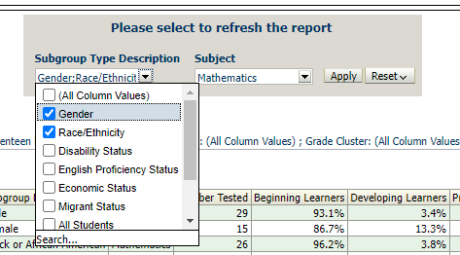
Example Cont.
1. Subgroup Type Description: Gender; Race/Ethnicity
2. Subject: Mathematics
3. Apply
Unclick box next to (All Column Values) to be able to select certain subgroup type descriptions
Notes:
I am going to show you quickly how to do this with an example, and next we are going to look at our own schools. So stick with me for this example and then feel free to look at your own school’s data.
Notice the number of students tested in 2020-21 school year is much less than the number tested in 2018-19. As a person analyzing this data, I would make sure to register this and check my assumptions about the extent to which this performance data is representative of the actual numerical population of the school.
Understanding the data limitations inherent in a smaller sample size due to testing changes in the 20-21 school year, I know I need to interpret these results with caution and not make sweeping generalizations about the school population based on this small sample. However, I see from the racial data that the % of beginning, developing, and proficient learners in math do differ by race/ethnicity. In fact, Hispanic students at this school are performing higher on math EOGs than Black/AA students during the 20-21 school year.
As a school leader, this finding could have some important implications on the way I think about ancillary STEM-focused enrichment for this population of students. It could also inform the specific population of students I seek to address when I apply for grants focused on under performing students.
Alternatively, this could also have me thinking about the ways in which my teachers are uniquely benefiting the Hispanic students at my school and could push me as a leader to further investigate strategies that are working and see how they can be applied to our Black/AA students.

Slide 13
Implications of Report Card Data for Your School/School District
If you have your laptop, look at your own school’s data on the Report Card and consider how this data can be useful.
If you don’t have a laptop, find a partner that does have a laptop and discuss the ways this data can be useful to your school/school district.
Share With Us:
How does this data help you with school improvement plans and other goals?
How can you share this data with your teaching staff in a way that is digestible and effective?
How can you communicate this data to the parents in your school and your community partners?
gosa.georgia.gov → Dashboards, Data, Report Card → Report Card → K-12 Public Schools
Georgia Assessments (Current)
Select your district and school, then click Apply
Notes:
10 minutes

Slide 14
Navigating Other GOSA Dashboards
gosa.georgia.gov → Dashboards, Data, Report Card → Data Dashboards
1. Discipline Dashboard
School Year: 2021
District: Harris County
School: Harris County High School
Subgroup: Disability Status
2. High School Graduate Outcomes
School Year: 2018
District: Muscogee County
School: Northside High School
3. School Grades
Click Schools
Filter by District: Ware County
Filter by School: Ware County Middle School → CLICK
Scroll to Compare to Other Schools/Districts → ENTER Appling County Middle School
Notes:
10 minutes

Slide 15
Usefulness of Other GOSA Dashboards
If you have your laptop, look at your own school’s data on dashboards described below and consider how this data can be used to meet school/school district goals.
If you don’t have a laptop, find a partner that does have a laptop and discuss how this data can be used to improve outcomes/meet goals.
Share With Us:
Graduate Outcomes:
How does data around students’ college enrollment patterns (USG vs. TCSG) inform your practice?
Discipline:
Discuss how school/district policies might need to change based on ISS and OSS in your school/district. How can you communicate with teachers this data in a way that is useful and practical?
School Grades:
How can you communicate to parents and community partners what this data means?
gosa.georgia.gov → Dashboards, Data, Report Card
Notes:
10 minutes

Slide 16
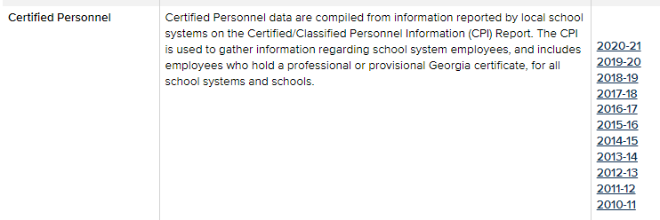
Downloadable Data & Additional Resources
gosa.georgia.gov → Dashboards, Data, Report Card → Downloadable Data
Certified Personnel
Click on the school year to download the data

Slide 17
Questions and Contact Information
Monica Flamini, PhD.
Research & Policy Analyst
Phone: 404.640.1051
Email: monica.flamini@gosa.ga.gov
Michael D. Moore
BI and Data Warehouse Architect
Phone: 706.401.3946
Email: michael.moore@gosa.ga.gov
Stacey Lutz
Director, Strategic Programs and Evaluations
Phone: 404.640.9667
Email: stacey.lutz@gosa.ga.gov
Jayashree Krishnan
Senior Enterprise Data Warehouse Architect
Phone: 404.520.5530
Email: jkrishnan@gosa.ga.gov

